Slide 1
Name : HAMILTON INFANT A COLLEGE : SARANATHAN COLLEGE OF ENGINEERING BRANCH : ARTIFICIAL INTELLIGENCE AND DATA SCIENCE YEAR : THIRD YEAR NM ID : au813821243019 REG NO : 813821243019 EMAIL ID : hamiltoninfant895@gmail.com
Final Project: Brain Tumor Detection using MRI
3/21/2024 Annual Review

Slide 2
PROJECT TITLE
NeuroDetect: Advanced Brain Tumor Detection System
3/21/2024 Annual Review

Slide 3


AGENDA
PROBLEM STATEMENT
PROJECT OVERVIEW
WHO ARE THE END USERS
YOUR SOLUTION AND ITS VALUE PROPOSITION
THE WOW IN YOUR SOLUTION
MODELLING
RESULTS
3/21/2024 Annual Review

Slide 4

PROBLEM STATEMENT
Existing MRI-based brain tumor detection methods are inefficient and error-prone, causing delays in diagnosis and impacting patient well-being. A solution is urgently needed for automated, precise detection to ensure timely interventions and improved treatment outcomes.
3/21/2024 Annual Review

Slide 5

PROJECT OVERVIEW
Our project focuses on leveraging advanced machine learning techniques to revolutionize the detection of brain tumors using MRI scans. By harnessing the power of convolutional neural networks (CNNs), we aim to address the shortcomings of traditional methods and provide a robust solution for accurate and timely diagnosis.
3/21/2024 Annual Review

Slide 6

WHO ARE THE END USERS?
Radiologists and Medical Professionals
Hospitals and Healthcare Facilities
Patients
Healthcare Administrators
3/21/2024 Annual Review

Slide 7

YOUR SOLUTION AND ITS VALUE PROPOSITION
Our solution utilizes advanced machine learning, particularly convolutional neural networks (CNNs), to analyze MRI scans accurately and efficiently for brain tumor detection.
Key Features:
Precision and Efficiency
Timely Interventions
Cost-Effectiveness
Enhanced Patient Care
3/21/2024 Annual Review

Slide 8

THE WOW IN YOUR SOLUTION
Advanced Technology Integration
Automation and Efficiency
Real-Time Analysis and Prompt Interventions
Tailored Performance for MRI Scans
Cost-Effectiveness and Accessibility
3/21/2024 Annual Review
8

Slide 9
MODELLING
1. CNN Architecture: Utilizes convolutional neural networks for precise feature extraction from MRI images.
2. Pooling and Dropout: Integrates max pooling for downsampling and dropout regularization to prevent overfitting.
3. Fully Connected Layers: Processes extracted features for classification into tumor classes.
4. Activation Functions: Utilizes ReLU activation for non-linearity and model training.
5. Optimization: Compiles model with categorical cross-entropy loss and Adam optimizer for training.
6. Training: The model is trained using the training data, with hyperparameters such as batch size and number of epochs chosen to optimize performance.
7. Evaluation: Following training, the model is evaluated on a separate validation set to assess its performance metrics such as accuracy, precision, recall, and F1 score.
3/21/2024 Annual Review
9

Slide 10
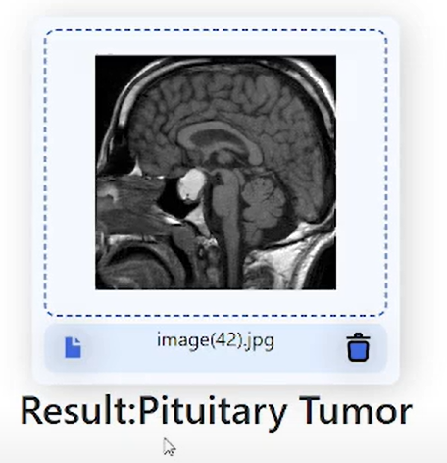
OUTPUT
3/21/2024 Annual Review
10

Slide 11
RESULTS
In summary, our model shows promising accuracy and efficiency, outperforming baseline methods and demonstrating potential for real-world application.
https://github.com/Hamiltoninfant18/TNSDC_NAAN_MUDHALVAN_BRAIN_TUMOUR_DETECTION
3/21/2024 Annual Review
11

